Slide 1
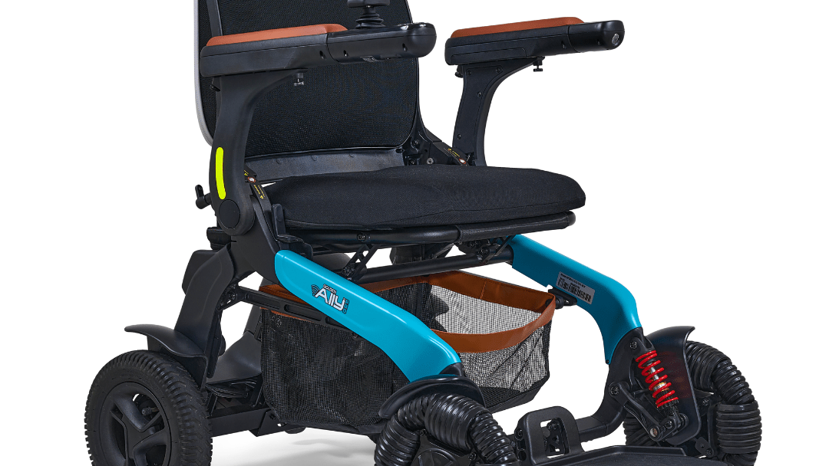
BIOMOVE
SMART WHEELCHAIR
Mobility + Healthcare + Safety + Rehabilitation
INTEGRATED HEALTHCARE MOBILITY

Slide 2
THE PROBLEM
75M+
ZERO
NO
NONE
People worldwide rely on wheelchairs daily
Health monitoring in traditional wheelchairs
Real-time safety alerts for falls or obstacles
Remote visibility for caregivers
Traditional wheelchairs are passive mobility devices with no intelligence, no monitoring, and no safety net. Users and caregivers are left in the dark about health status, safety risks, and rehabilitation progress.
BIOMOVE

Slide 3
OUR SOLUTION
Not Just a Smart Wheelchair
An Integrated Healthcare Mobility Platform
SMART MOBILITY
HEALTHCARE
SAFETY
REHABILITATION
Dual control via joystick + app
Real-time vital monitoring
4-layer protection system
EMG muscle activity tracking
Controlled via Mobile Application | Real-time vitals: HR, SpO2, Temp, EMG | AI-ready architecture
BIOMOVE

Slide 4
KEY FEATURES
DUAL CONTROL
VITAL MONITORING
MULTI-LAYER SAFETY
REHABILITATION
Joystick + Mobile App via BLE
HR, SpO2, Temperature, EMG
Obstacle, Fall, Temp, Battery alerts
EMG muscle activity analysis
MOBILE APP
HEAVY DUTY
Full control & monitoring dashboard
Steel chassis, 100kg, 8km/h
MOBILITY + HEALTHCARE + SAFETY + REHABILITATION
BIOMOVE

Slide 5
SYSTEM ARCHITECTURE
SENSOR ARRAY
BLE
MOBILE APP
ESP32-S3
HR/SpO2
TEMP
EMG
IMU
ULTRASONIC
BATTERY
GPS
CLOUD (FUTURE)
24V MOTORS
STEEL CHASSIS
BIOMOVE

Slide 6
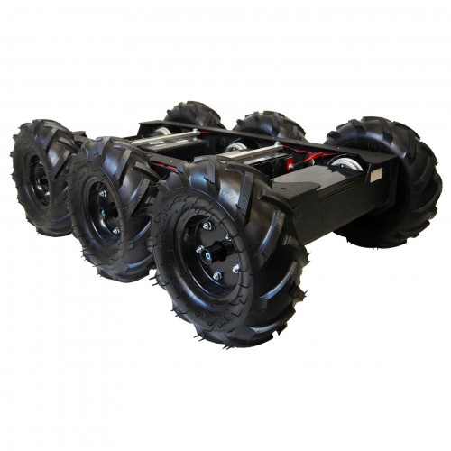
HARDWARE COMPONENTS
ESP32-S3
EMG SENSOR
Dual-core MCU with WiFi + BLE
Muscle Activity Detection
MAX30102
MPU6050
Heart Rate & SpO2 Sensor
6-Axis IMU for Fall Detection
MLX90614
HC-SR04
Contactless Temperature Sensor
Ultrasonic Obstacle Detection
24V DC Motors
Li-ion 24V Battery
Motor Driver Board
Steel Chassis Frame
BIOMOVE

Slide 7
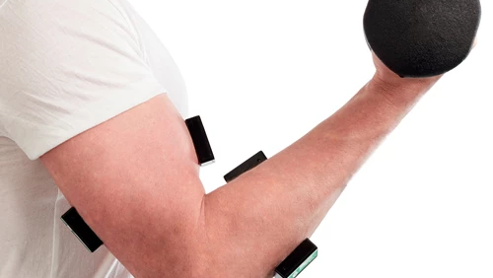
GAME CHANGER
EMG SENSOR
First wheelchair-integrated EMG rehabilitation platform — transforming muscle signals into actionable health insights.
MUSCLE MONITORING
REHABILITATION
Real-time EMG signal acquisition and visualization
Track muscle recovery progress over time
FATIGUE DETECTION
FUTURE CONTROL
Early warning before muscle overexertion
Navigate wheelchair using muscle signals only
EMG CONTROL COMING SOON
BIOMOVE

Slide 8
SAFETY SYSTEM
OBSTACLE DETECTION
Ultrasonic sensors detect obstacles + automatic braking system
4-LAYER PROTECTION
FALL DETECTION
Multi-sensor safety network for maximum protection
IMU-based 6-axis motion analysis detects falls instantly
TEMPERATURE ALERT
Real-time body temperature monitoring with smart thresholds
BATTERY WARNING
Low voltage alert with remaining range estimation
EMERGENCY STOP — Immediate motor cutoff
BIOMOVE

Slide 9
MOBILE APPLICATION
BIOMOVE
REAL-TIME DASHBOARD
Live vitals display with trend graphs and history
Heart Rate
SpO2
72
bpm
98
%
VIRTUAL JOYSTICK
Temperature
EMG
Full wheelchair control with speed adjustment
36.5
°C
0.85
mV
SAFETY ALERTS
Push notifications for all safety events
REHABILITATION MODE
EMG signal visualization and muscle history
SMART SETTINGS
BLE pairing, thresholds, user profiles
BIOMOVE

Slide 10
MECHANICAL DESIGN
STEEL CHASSIS
Industrial-grade steel construction for maximum durability
6-WHEEL DRIVE
Enhanced stability and all-terrain maneuverability
24V DC MOTORS
Powerful yet efficient drive system
100 KG
8 KM/H
24 V
Load Capacity
Max Speed
Motor Voltage
BIOMOVE

Slide 11
EMBEDDED SOFTWARE
POWER ON
SENSOR INIT
BLE CONNECT
MAIN LOOP
MAIN LOOP CYCLE
READ SENSORS
PROCESS DATA
SEND VIA BLE
CHECK SAFETY
MOTOR CONTROL
BIOMOVE

Slide 12
TESTING
LOAD TEST
SPEED TEST
BATTERY TEST
Gradual loading up to 100kg rated capacity
Acceleration and maximum speed verification
Continuous operation duration measurement
PASSED ✓
PASSED ✓
PASSED ✓
BLE RANGE TEST
DUAL CONTROL TEST
Connection stability at various distances
Joystick and app switching verification
PASSED ✓
PASSED ✓
BIOMOVE

Slide 13
RESULTS
100 KG
8 KM/H
6+ HRS
LOAD CAPACITY
MAX SPEED
BATTERY LIFE
PASSED ✓
PASSED ✓
PASSED ✓
10 HZ
DUAL CONTROL
BLE UPDATE RATE
SEAMLESS SWITCHING
PASSED ✓
PASSED ✓
BIOMOVE

Slide 14
BIOMOVE VS TRADITIONAL
FEATURE | ● BIOMOVE | TRADITIONAL
Health Monitoring | ✓ Full vitals + EMG | ✗ None
Safety System | ✓ 4-layer protection | ✗ Manual only
Control | ✓ Dual mode + App | ✗ Manual only
Rehabilitation | ✓ EMG tracking | ✗ None
Connectivity | ✓ BLE + Cloud-ready | ✗ None
BIOMOVE: PLATFORM | TRADITIONAL: DEVICE ONLY
BIOMOVE

Slide 15
FUTURE WORK
AI INTEGRATION
VOICE CONTROL
CLOUD PLATFORM
Predictive health analytics and anomaly detection from vital patterns
Hands-free wheelchair operation using voice commands
Remote patient monitoring dashboard for caregivers and doctors
PREDICTIVE HEALTHCARE
EMG CONTROL
Early disease detection from long-term vital trend analysis
Navigate the wheelchair using muscle signals only — no hands needed
ROADMAP 2025 — 2027
BIOMOVE

Slide 16
DEMO
LIVE DEMONSTRATION
Video playback or live system demonstration
Insert your demo video here
BIOMOVE

Slide 17
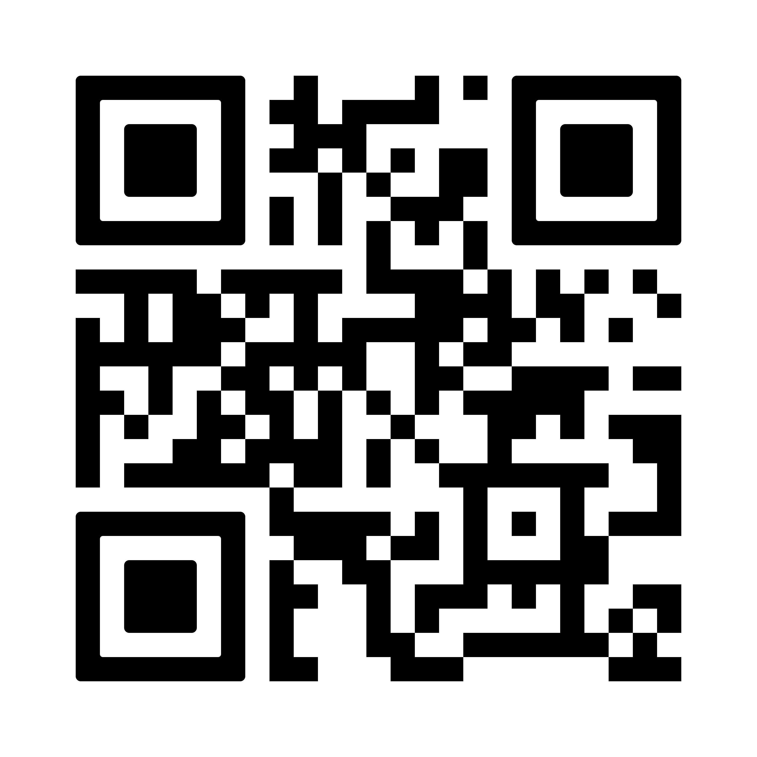
THANK YOU
BIOMOVE
Redefining Mobility Healthcare
Scan for Website
Smart Wheelchair Platform | Mobility + Healthcare + Safety

